Slide 1
Semantic Graph Databases and the Future of the Web
Diana Tamabayeva & Dan Delany

Slide 2
Database 1.0
Item ID | Description | Price
23392 | Apple | $2.33
94821 | Peanut Butter | $6.80
01165 | Frisbee | $5.00
84975 | Chips | $2.07
23425 | Kleenex | $1.25
93875 | Watermelon | $6.42
66355 | Coffee | $8.49
10184 | Tylenol | $7.20
Two-Dimensional Table of Data

Slide 3
Database 2.0 – Relational DB
Item ID | Sold at | Sold by
94281 | 11/4/08 9:38:08 | John G
00165 | 11/4/08 9:46:16 | John G
94281 | 11/4/08 9:48:56 | John G
Item ID | Description | Price
23392 | Apple | $2.33
94821 | Peanut Butter | $6.80
01165 | Frisbee | $5.00
84975 | Chips | $2.07
Uses unique key to lookup item in another table
Allows for rigidly structured relations between data
Used by all web apps, everywhere

Slide 4
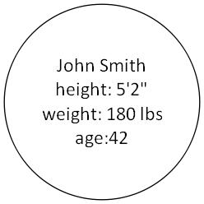
Database 3.0? – Semantic Graph
Data stored in object nodes

Slide 5
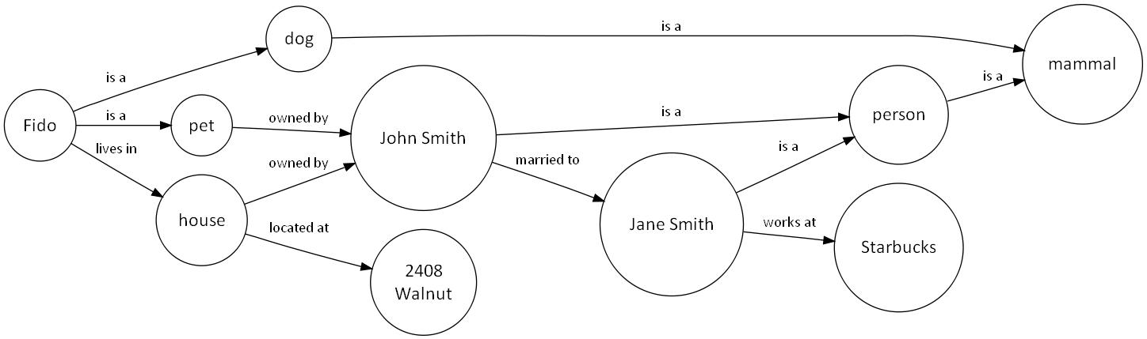
Database 3.0? – Semantic Graph
Graph represents semantic relationships between
pieces of information.
Good for large, complex datasets with variety.

Slide 6
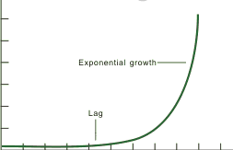
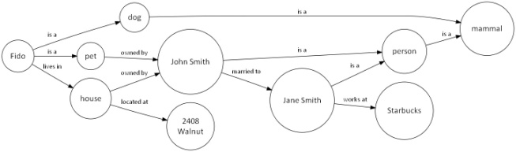
Data Structure Analysis
Dataset size
Data Complexity
Data Variety
Item ID | Description | Price
23392 | Apple | $2.33
94821 | Peanut Butter | $6.80
01165 | Frisbee | $5.00
84975 | Chips | $2.07
23425 | Kleenex | $1.25
93875 | Watermelon | $6.42
66355 | Coffee | $8.49
10184 | Tylenol | $7.20
Item ID | Description | Price
23392 | Apple | $2.33
94821 | Peanut Butter | $6.80
01165 | Frisbee | $5.00
84975 | Chips | $2.07
Item ID | Sold at | Sold by
94281 | 11/4/08 9:38:08 | John G
00165 | 11/4/08 9:46:16 | John G
94281 | 11/4/08 9:48:56 | John G

Slide 7
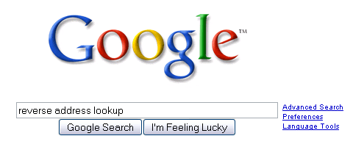
Why? Searchability.
Search engines require you to guess a phrase that might be in a document that might also contain the information you need, or guide you towards databases which might help:
“Where does the woman who lives at 2408 Walnut work?”

Slide 8
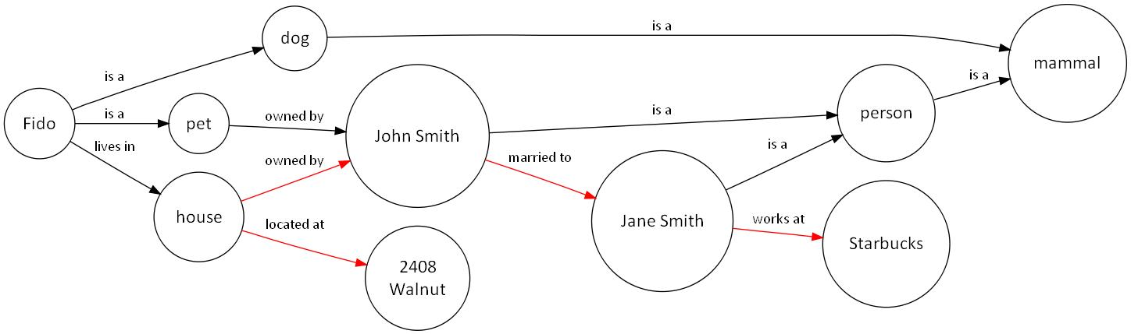
Why? Searchability.
With semantic graphs, you can perform semantic searches
by traversing the graph:
“Where does the woman who lives at 2408 Walnut work?”

Slide 9
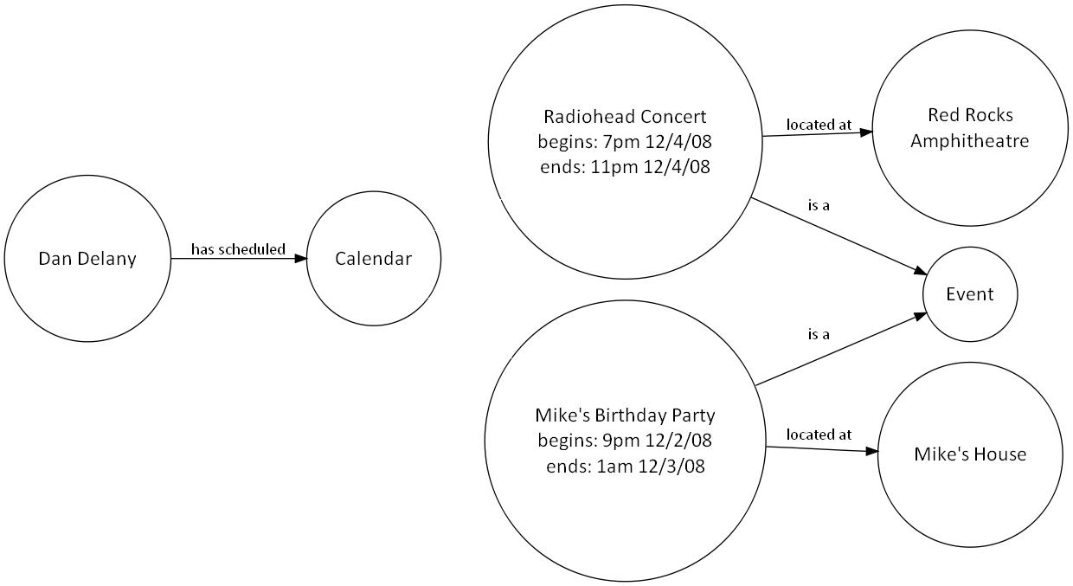
Why? Standard Types.
Standard methods for relationships between defined data types, eg. “Event” objects

Slide 10
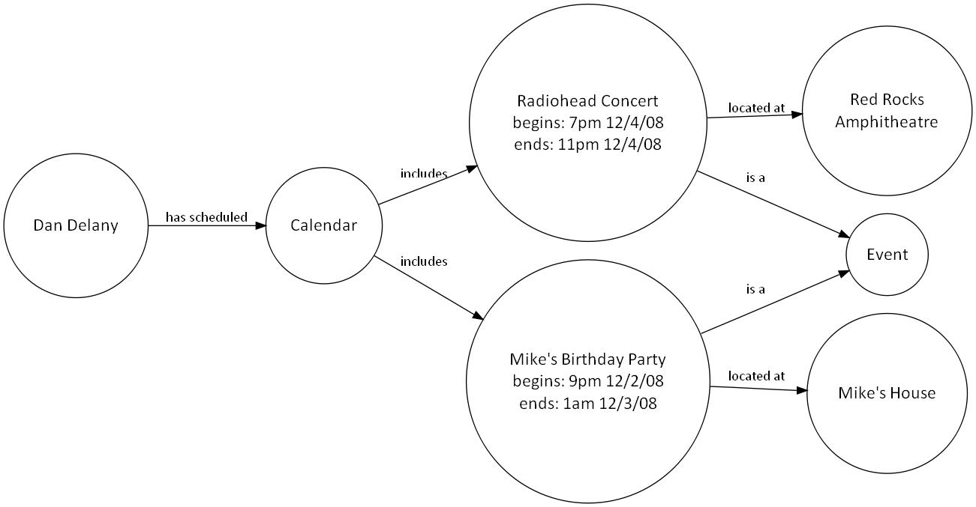
Why? Standard Types.
Standard methods for relationships between defined data types, eg. “Event” objects

Slide 11
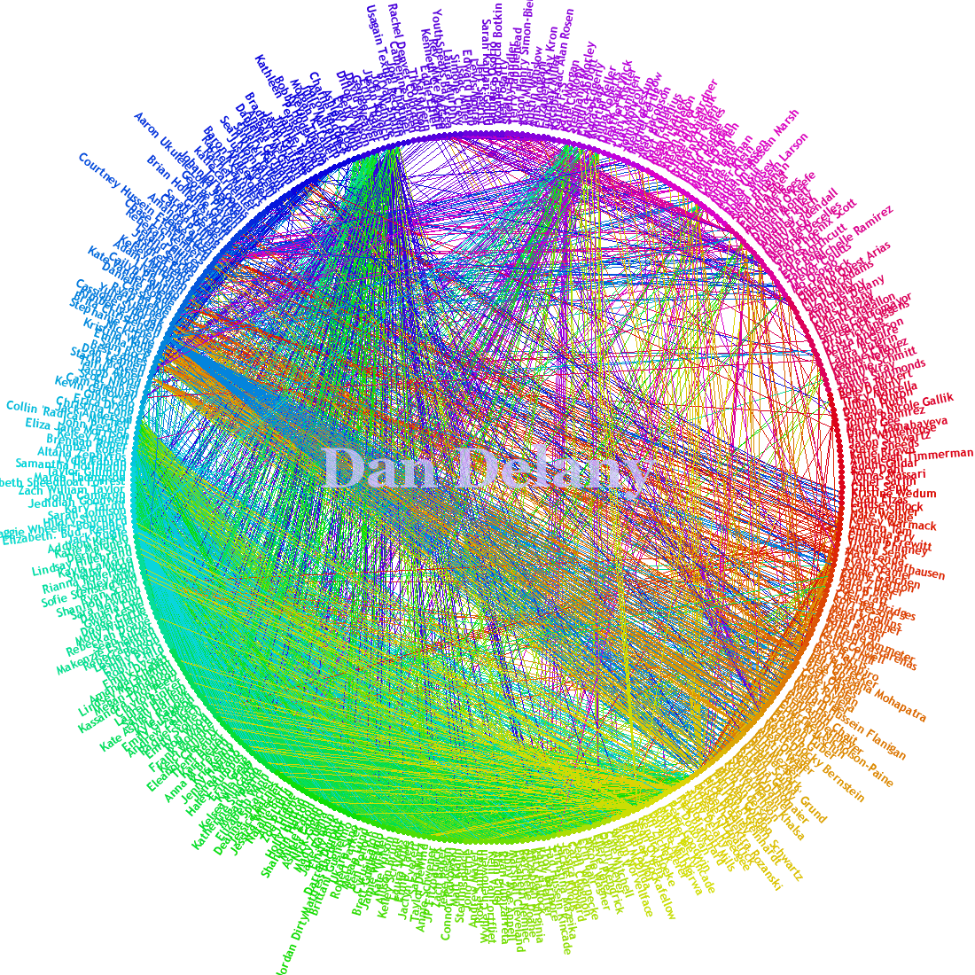
So What? The Social Graph.

Slide 12
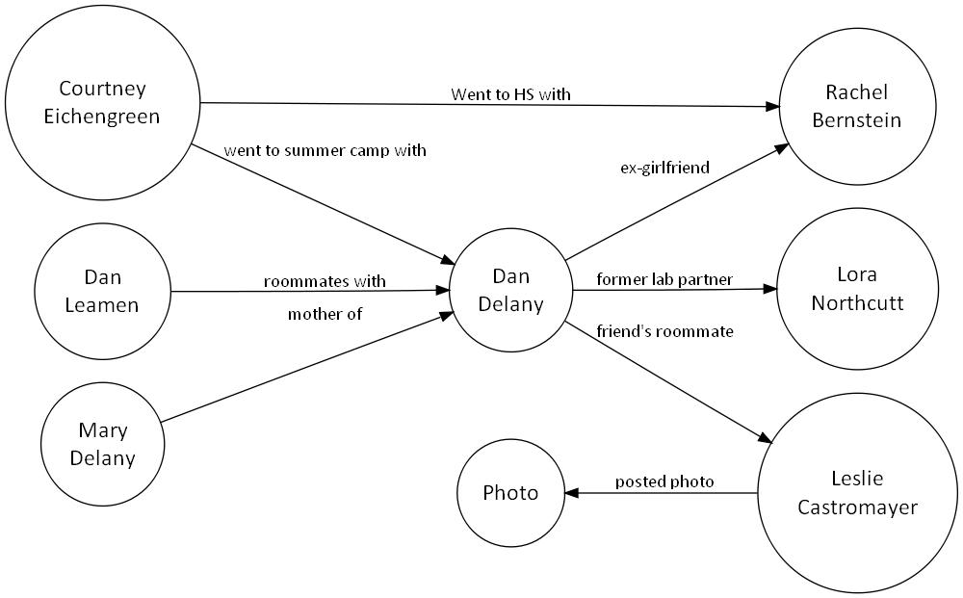
So What? The Social Graph.
Semantic social graph
Think bigger: events, plans, blog posts, photos, etc.

Slide 13
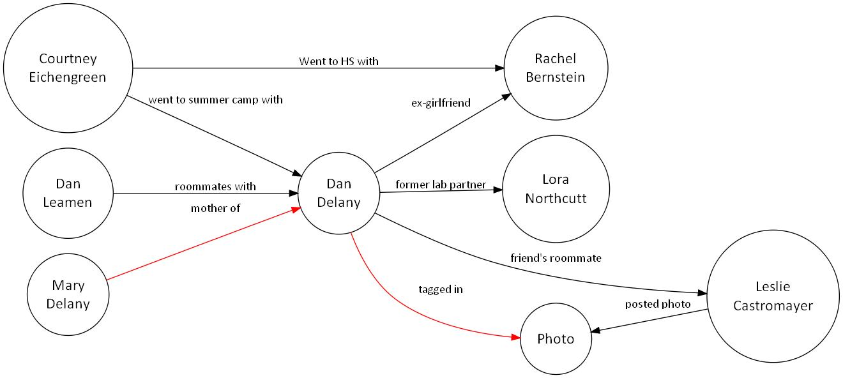
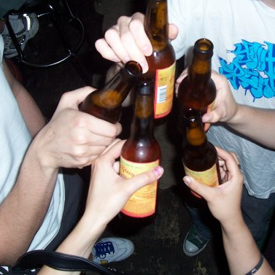
So What? The Social Graph.
Privacy:
How much of the web should one be allowed to see?

Slide 14
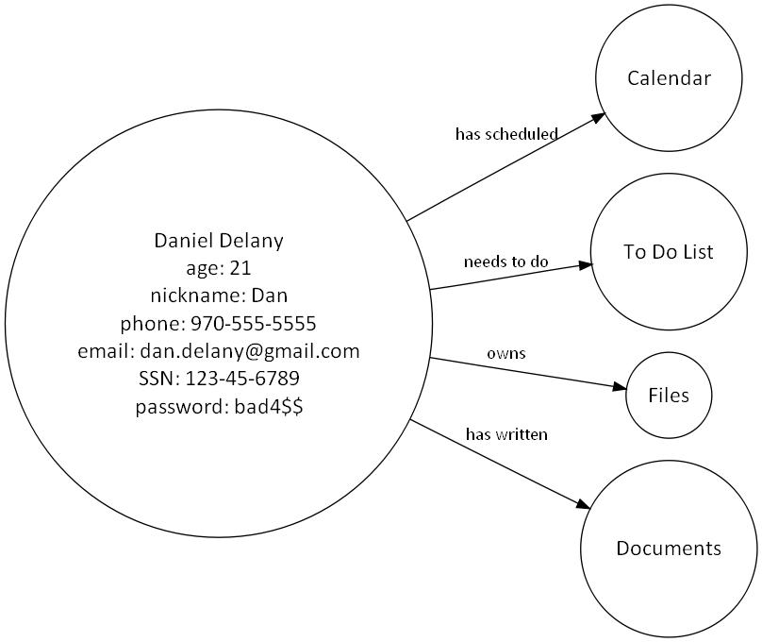
So What? The You Node.
Object-oriented relationship with all personal information
Use for federated authentication
Security concerns: different data requires different priveliges

Slide 15
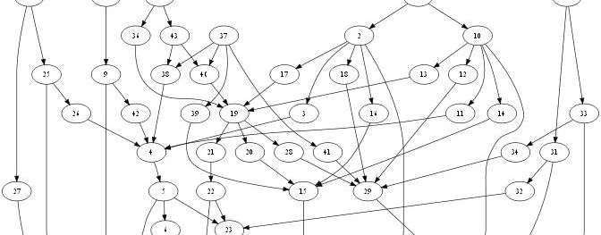
So What? The Collaborative Graph
Semantic graphs can support collaboration by allowing users to create nodes, and edit their properties and relations
A wiki is a sort of semantic graph

Slide 16
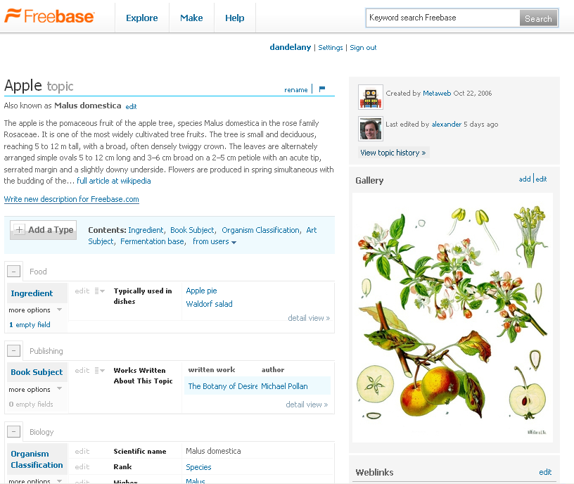
Freebase: The Everything Graph
Wikipedia-style effort to create exhaustive semantic network
Openly editable
Growing community of content publishers
Full, open source developer API allows scripted reading from and writing to the canonical graph

Slide 17
Questions…
How does the semantic graph data structure change the way people create and interact with data?
Which domains are best for semantic graphs?
How scalable and technically feasible is the implementation of a huge semantic graph?
How can we best interact with these semantic graphs? Visualizations? NLP?

