Slide 1
Improving Google Maps Walking Directions
By Isaac Guerrero, Tom Huber, Kyle Madruga

Slide 2
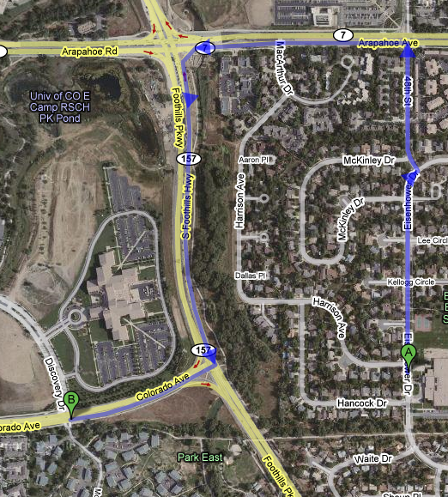
Meeting the Needs of Google Users
…I think it would be nice if we could edit roads like we do addresses - click Edit, and drag the road…
…If bike trails could show up on the map view in a different color then the streets, that would be a huge help! ...
…how about a feature that maps out more than one route at a time? …
…for my country there are a lot of roads that aren't viable with cars, but are with a bike or by foot. When I wanted to plan a trip based on some directions I got from a friend, I was unable to use the built-in planning feature….

Slide 3


Slide 4
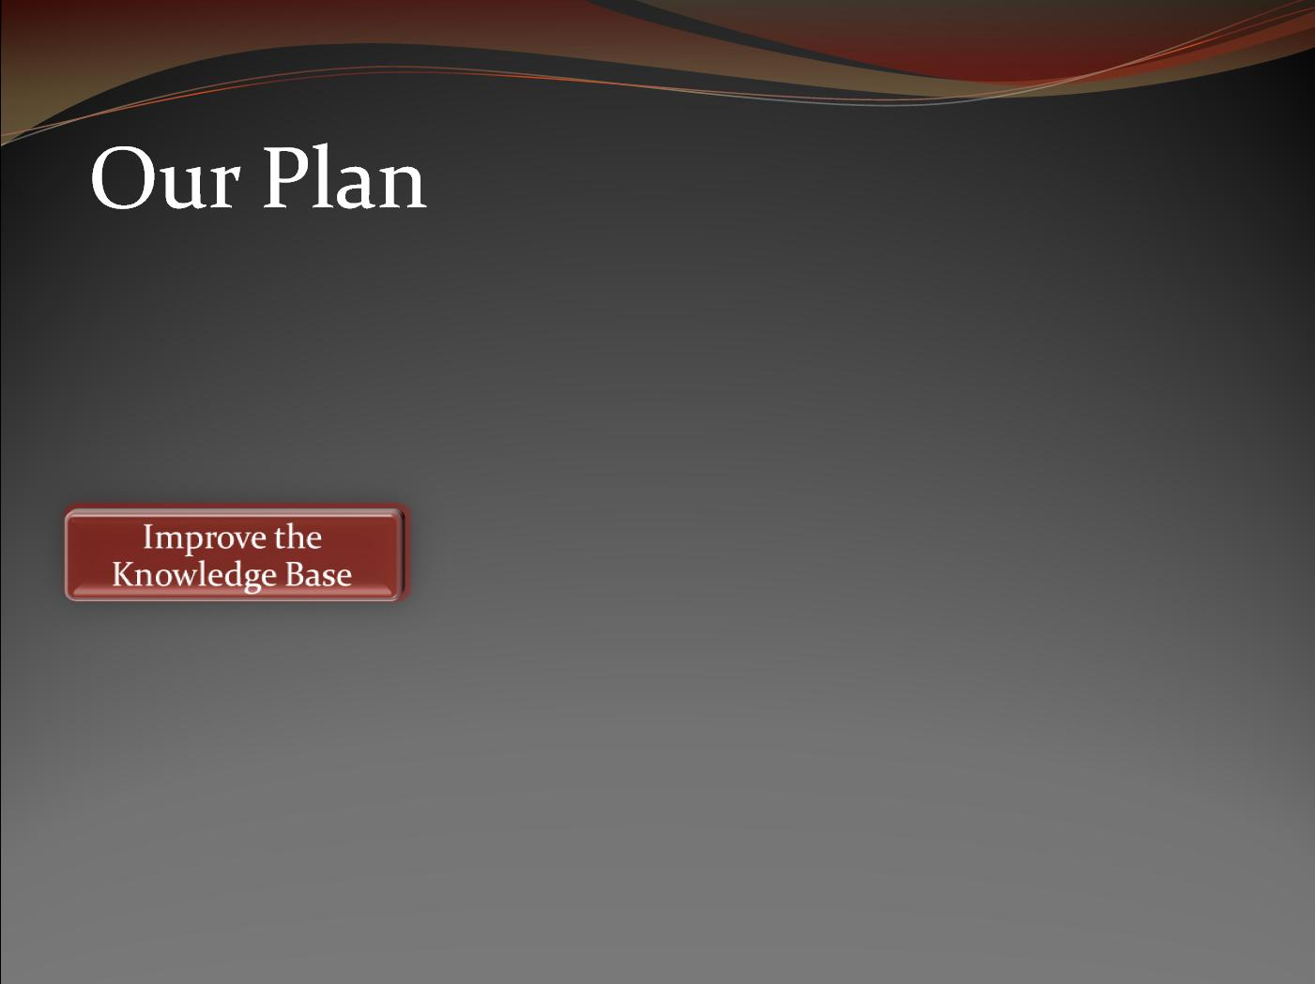

Slide 5
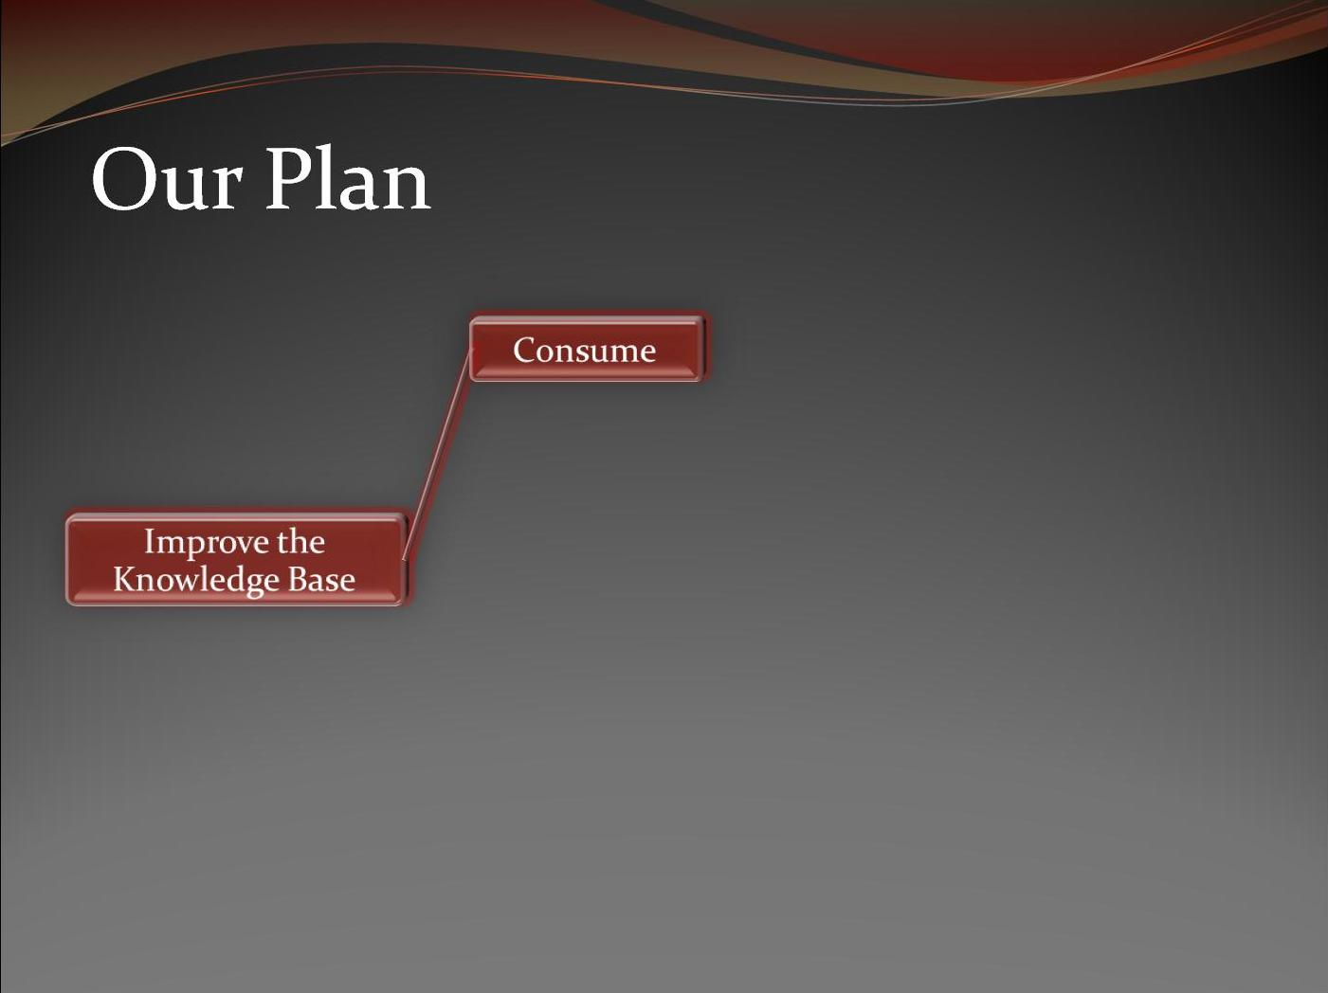

Slide 6
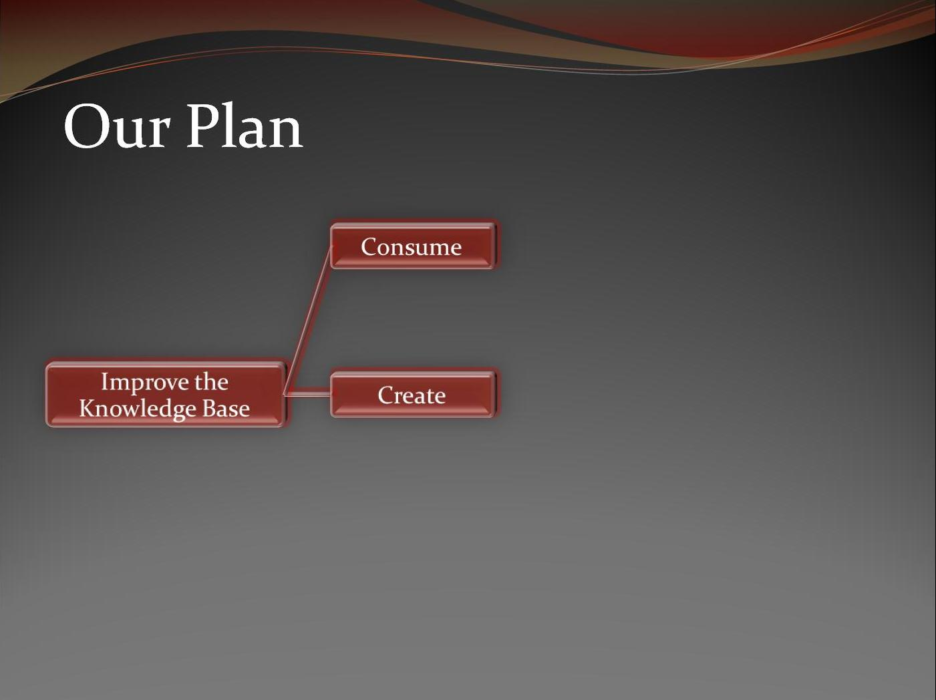

Slide 7
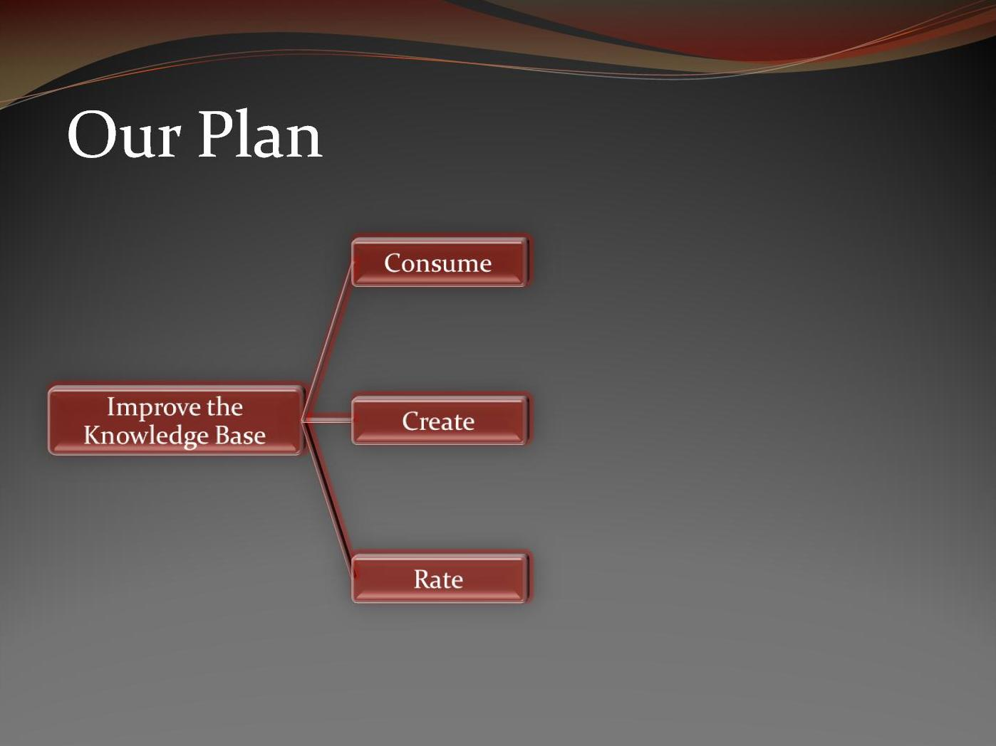

Slide 8
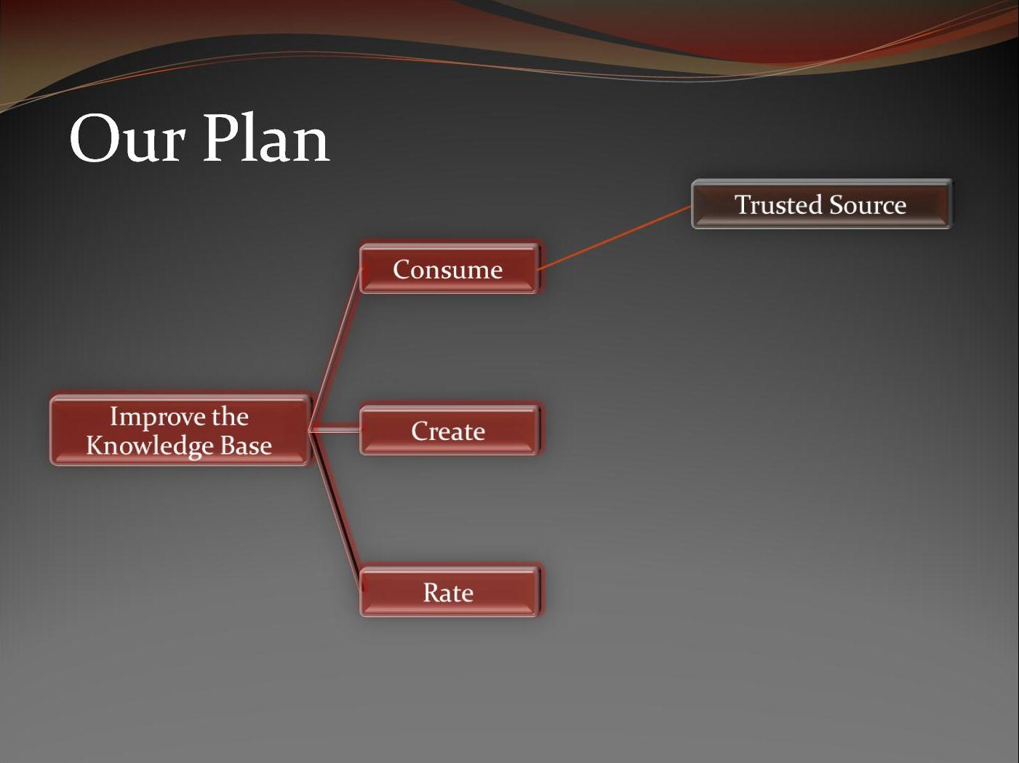

Slide 9
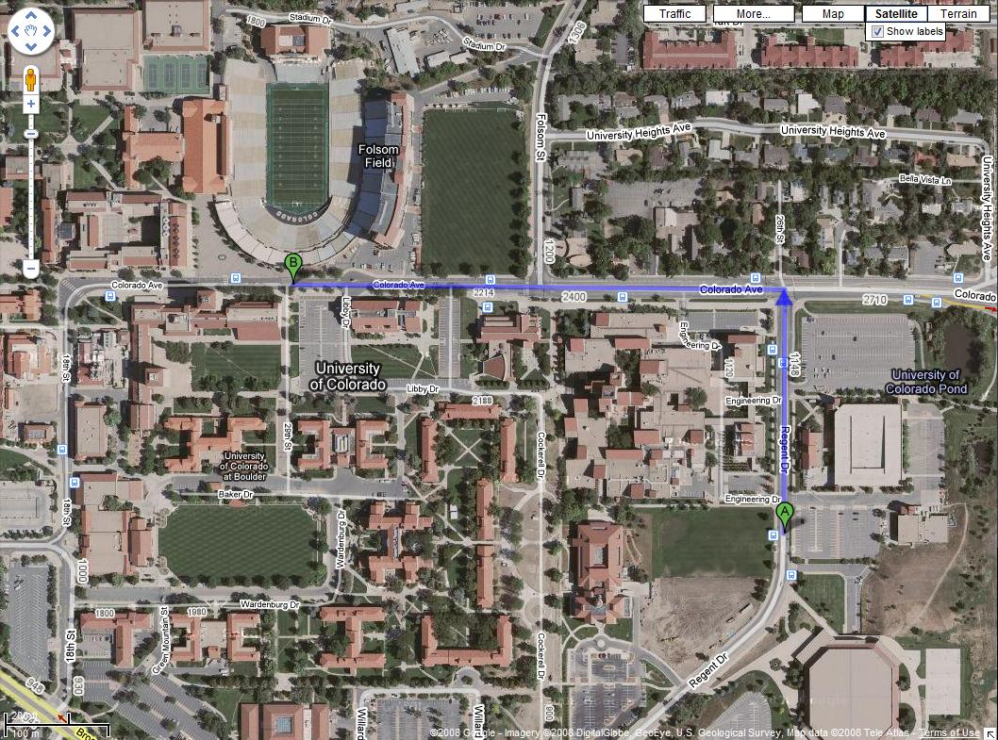

Slide 11
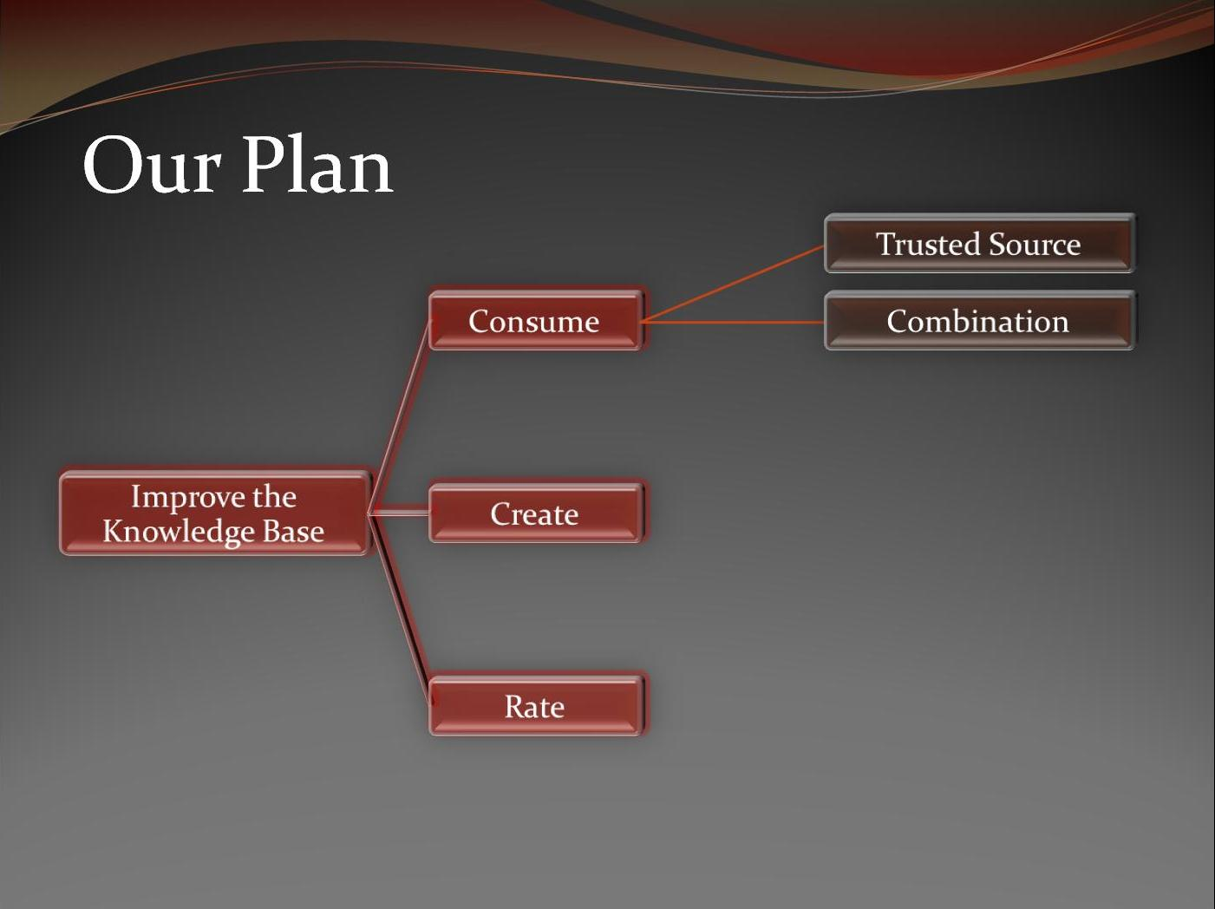

Slide 12
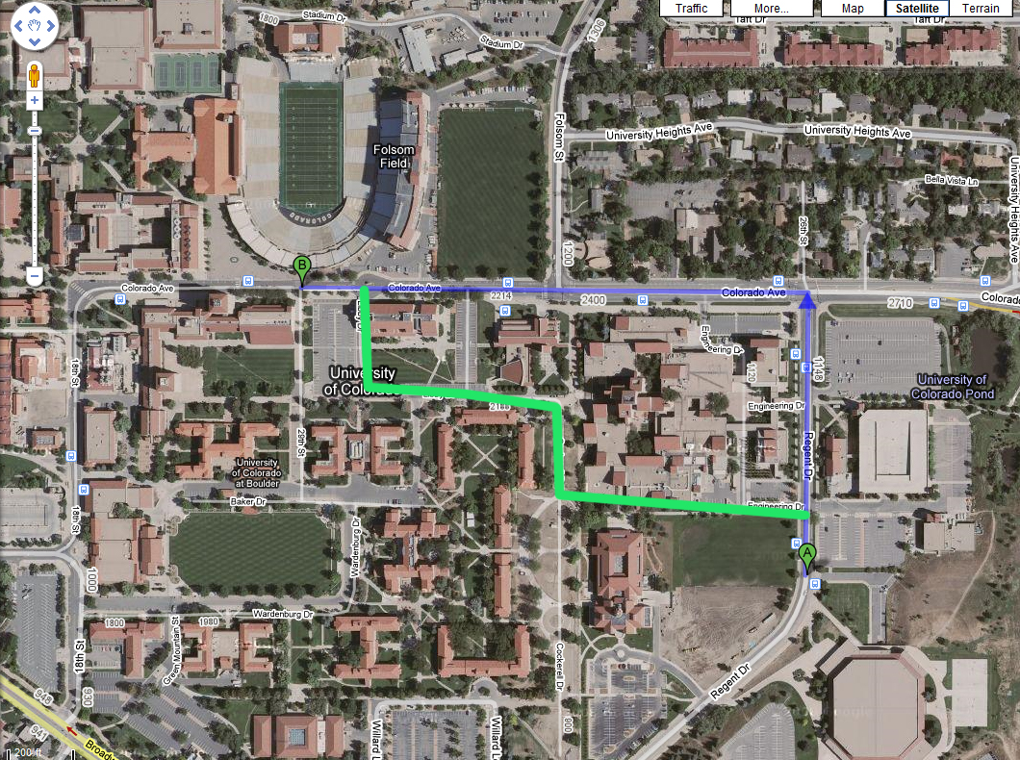

Slide 14
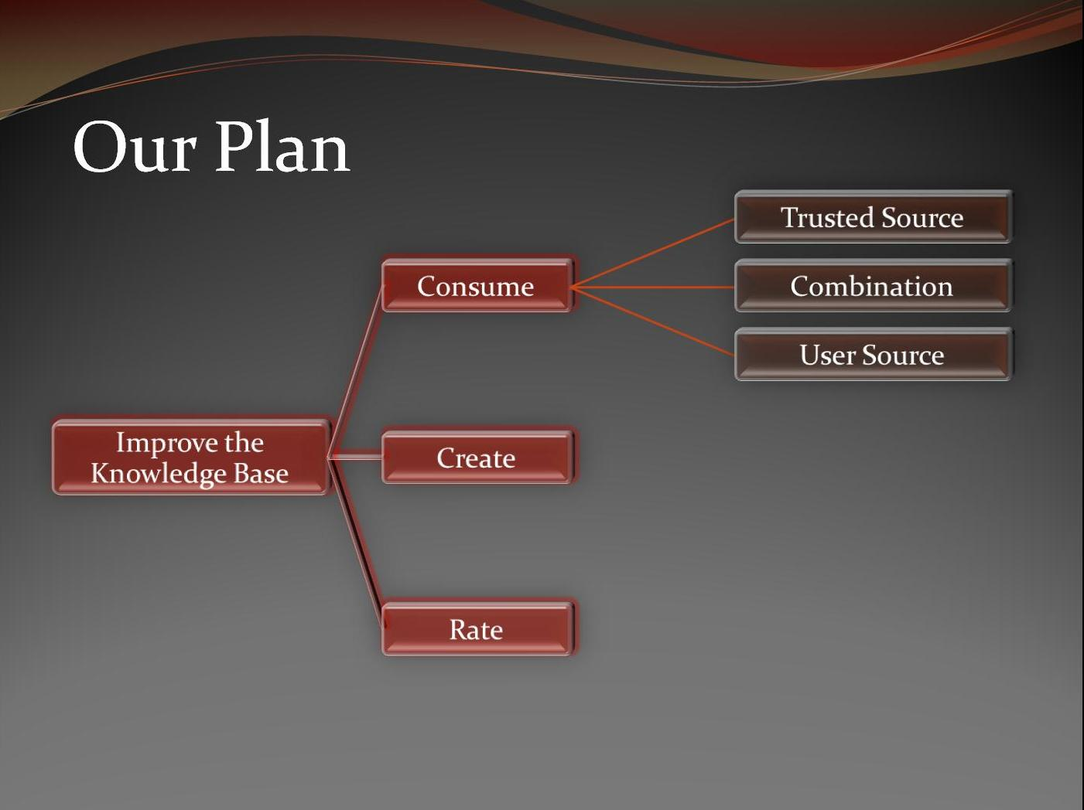

Slide 15
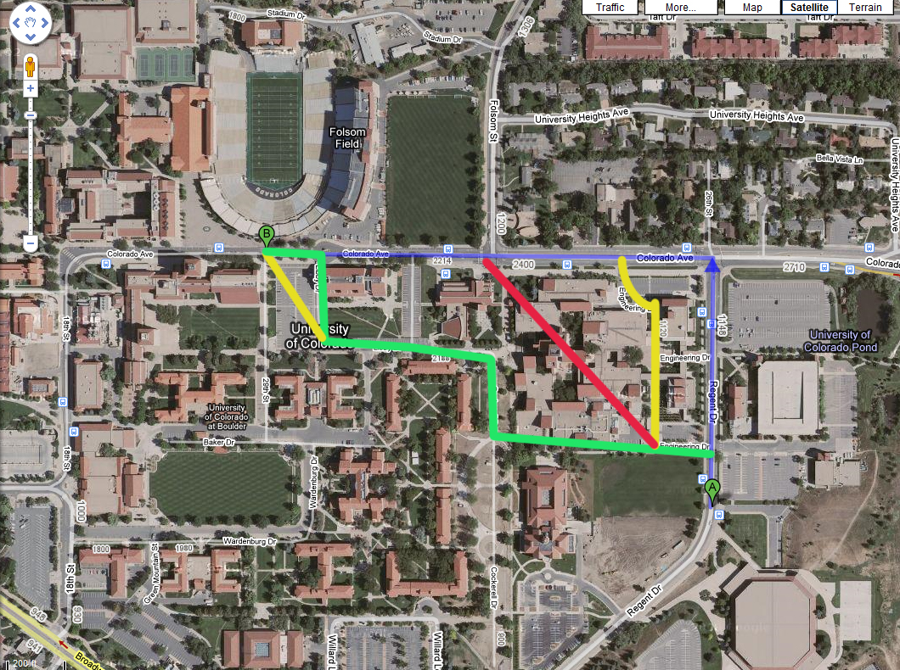

Slide 17
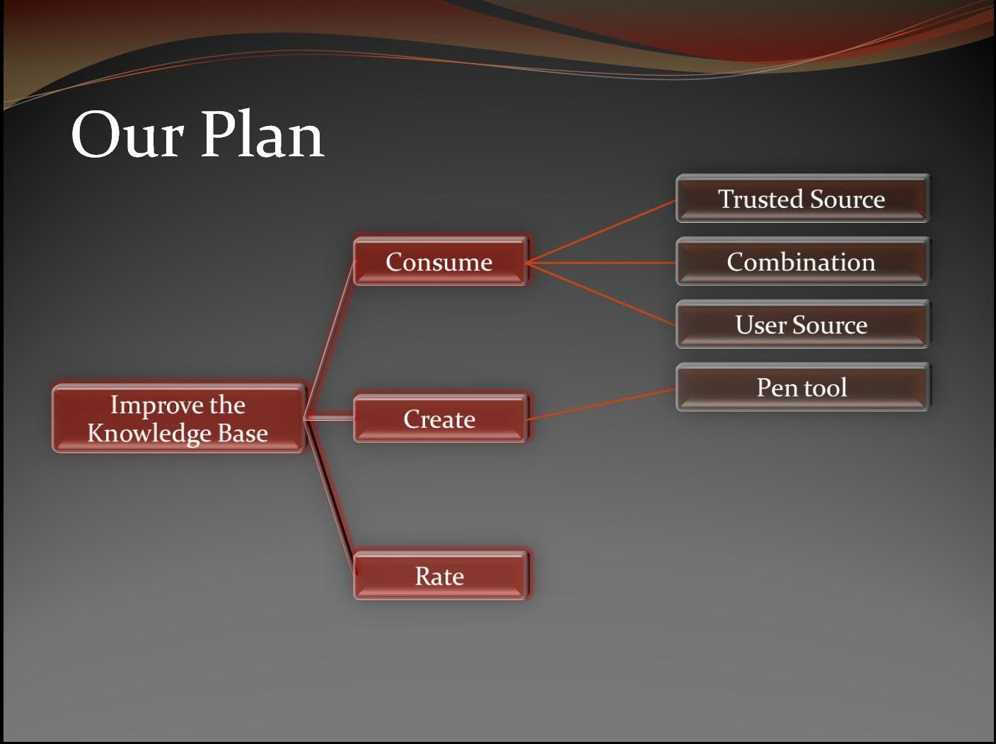

Slide 18
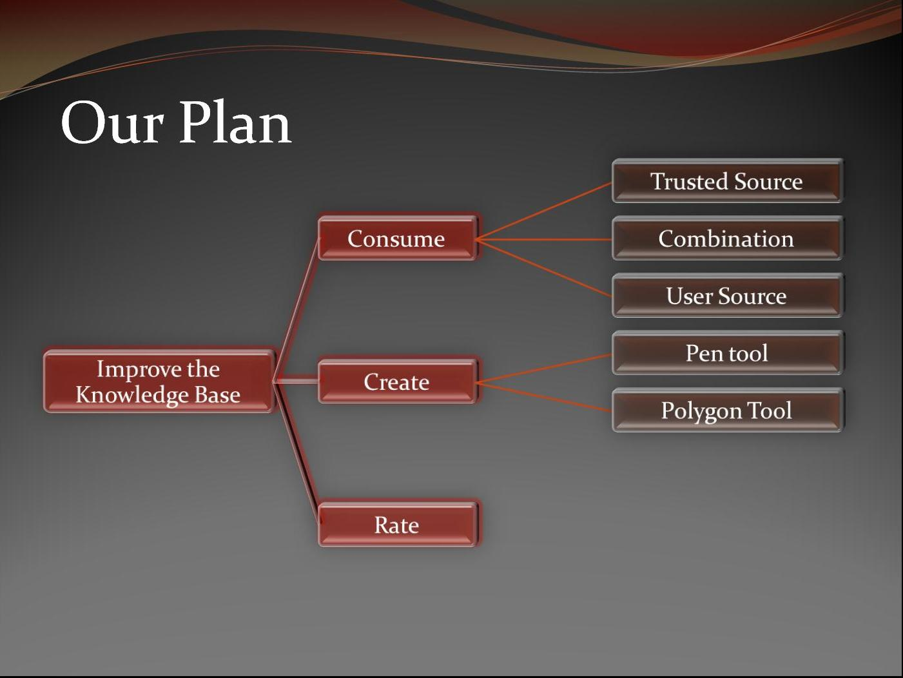

Slide 19
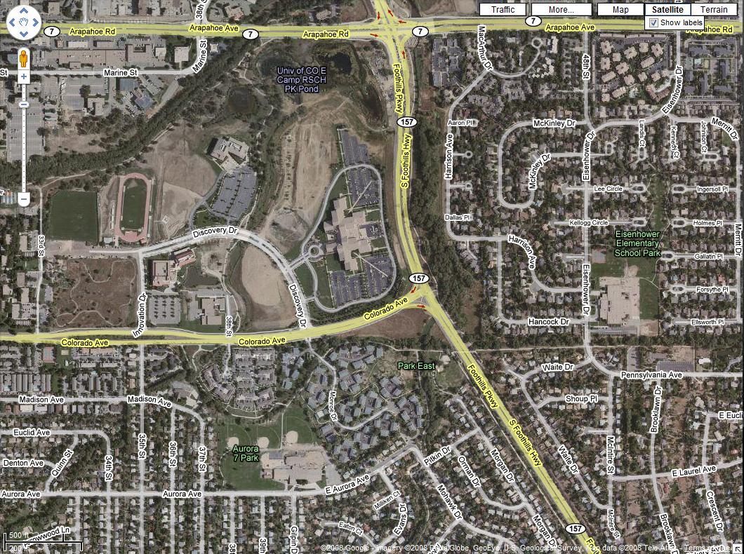

Slide 20
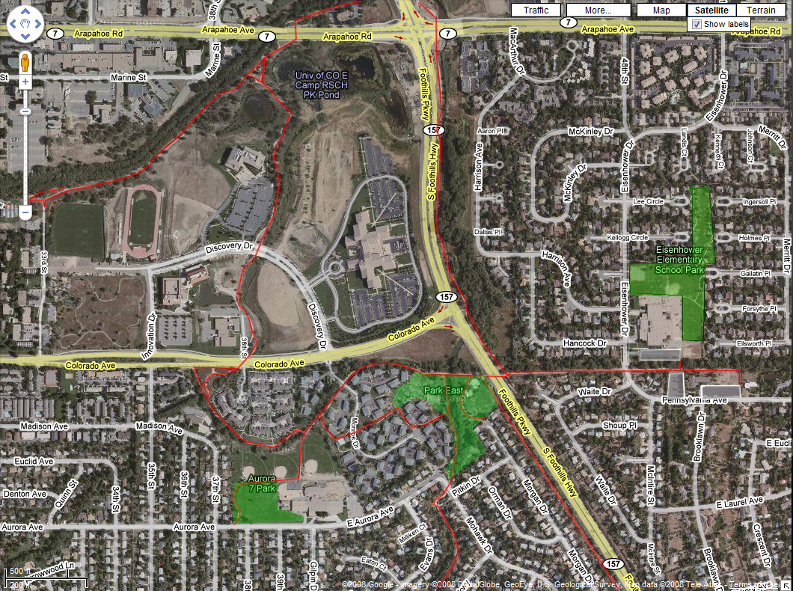

Slide 22
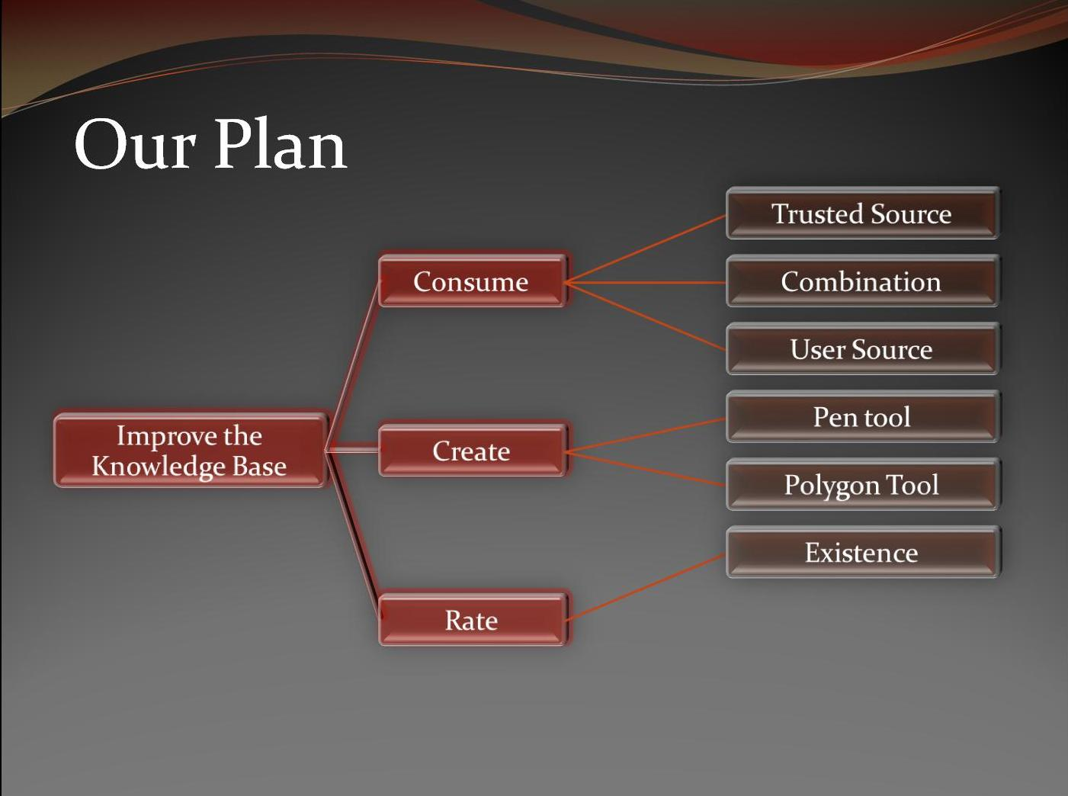

Slide 23
Does this path exist?
Yes
No

Slide 25
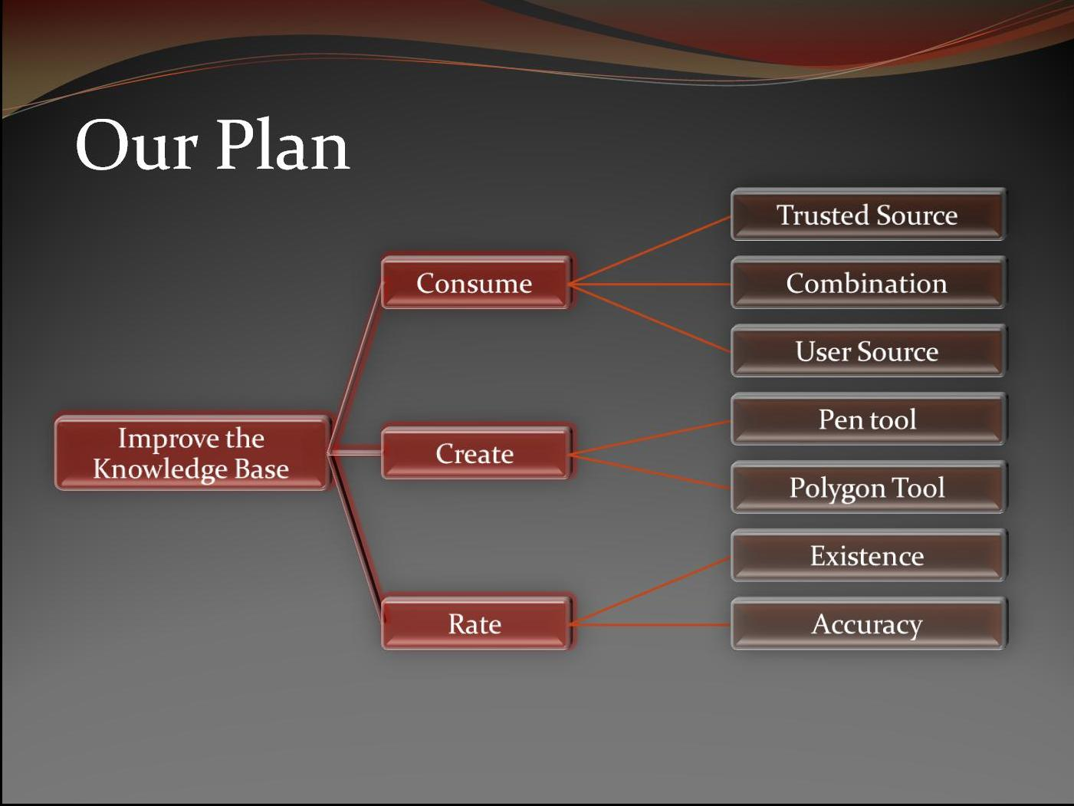

Slide 26
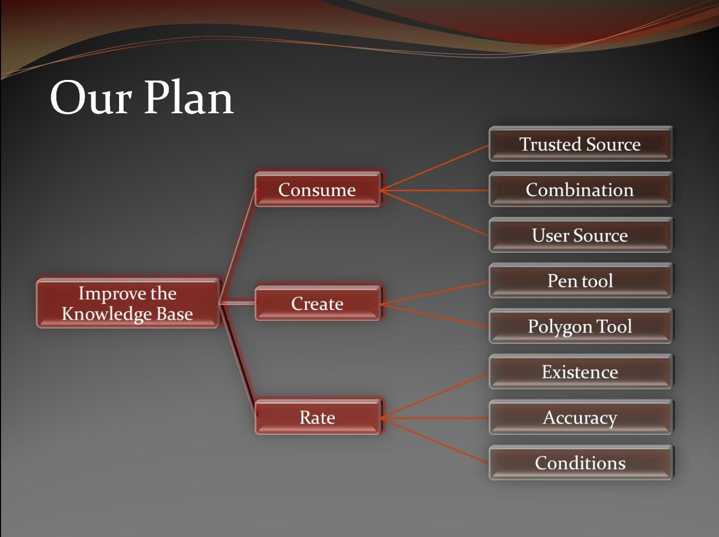

Slide 27
This bridge is under construction from June to July

Slide 28
Improving the Database
Send an email to users logged into a Google Account about their experience
  Only send emails to users who are logged into Google
  Never request information from other users
  Allow a user to opt out of receiving emails at any time
  Ask users to rate the user contributed content along their path

Slide 29
Improving the Database
Send an email to users logged into a Google Account about their experience
  Only send emails to users who are logged into Google
  Never request information from other users
  Allow a user to opt out of receiving emails at any time
  Ask users to rate the user contributed content along their path
Most people we surveyed felt that this system would help to improve
the system without becoming too intrusive

Slide 30
From Our Results
The Majority of People:
  Use Google Maps More than Twice a Month (37%)
  Have Either Used Google Maps for Walking Directions
or Knew That They Could (59.2%)
  Trusted the Directions They Received (72%)
  Believed That There was a Need for Our System (93.6%)
  Preferred A Combination of User and Trusted Paths (59.3%)
  Preferred Large Scale Accuracy to Small Scale Accuracy (66.7%)
  Equally Favored Visual and Textual Directions

Slide 31
Future Work
Explore developing in conjunction with Google
  We currently don’t have access to Google Maps’ code
Present our work to a large user base
  Create a mock-up
  Get user feed-back
  Refine our prototype

Slide 32
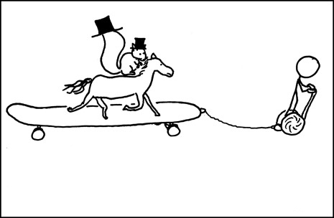
Any Questions?

