Slide 1
Umbrella Project
Motivations for Online Contributions

Slide 2

Introduction
Purpose
  What motivates users to contribute to online information repositories?
  How does this differ across varying environments?
    Story-telling website
    Google’s 3D warehouse
    Game-programming class and website

Slide 3
Background
What is an ‘Information Repository’?
  AKA ‘Information Commons’
  “Information resources shared by a community of producers and consumers in an open access environment”

Slide 4
Background
What is an ‘Information Repository’?
  Artifact Creation vs. Communication
    StoryGaps vs. Facebook
  Multiple, individual products vs.
  Single, collaborative product
    3D Warehouse vs. Open Source

Slide 5
Background
What is an ‘Information Repository’?
  Four main components
    People
      Those who are involved
    Content
      Artifacts they produce and share
    Feedback
      Engagement between people around content
    Distribution
      The way in which people discover and consume content

Slide 6
Background
What did we find?
  A lot of central themes
    Social Capital
    Social Learning Theory
    Gift Economies / Gift Cultures
    Utility
    Generalized Reciprocity
    Group Theory
    Distinct User Roles

Slide 7
Social Capital
What is Social Capital?
  “Resources available to individuals through their membership in community networks.”
    Networks with lots of resources
    Membership in lots of networks

Slide 8
Social Learning Theory
What is Social Learning Theory?
  We can learn by observing the behaviors of others and the outcomes of those behaviors

Slide 9
Social Learning Theory
What is Social Learning Theory?
  “Social learning theory suggests that people learn by observation in social situations, and that they will begin to act like people they observe even without external incentives.”

Slide 10
Social Learning Theory
What is Social Learning Theory?
  “It is through reading archived conversations that newcomers determine whether the potential benefit of membership is worth the cost of participation.”
    Utility = Cost/Effort
  “Newcomers who see their friends contributing go on to share more content themselves.”

Slide 11
TIP Theory
What is TIP Theory?
  Time, Interaction, and Performance
  A generalized theory that describes groups and how they do what they do
  “Many of the groups we meet in everyday living... have pasts together, and they expect to have futures.”
  Three main functions of a group
    Production Function
    Member-Support Function
    Group Well-Being Function

Slide 12
TIP Theory
What is TIP Theory?
  “A temporally efficient flow of work in groups requires complex matching of bundles of activities to particular periods of time.”
  “Acts have situated, rather than generic, meanings in relation to the modes, functions, and paths of group activity.”
  “In order to survive, online communities, like face-to-face groups, must meet the needs of individual members and the group as a whole.”

Slide 13
Reciprocity
What is Generalized Reciprocity?
  Individuals donate to a large social network with an expectation that an undefined contribution will be repaid in the future, even by simply being a member of the network

Slide 14
Gift Economies
What is a Gift Economy?
  Social status is determined not by what you control but by what you give away

Slide 15
User Roles
Do users take on specific roles?
  In Multi-User Dungeons
    Similar to MMORPG
    Four user roles
      Killers
      Achievers
      Socialisers
      Explorers

Slide 16
Belonging
  "The need to belong is a powerful, fundamental, and extremely pervasive motivation."

Slide 17

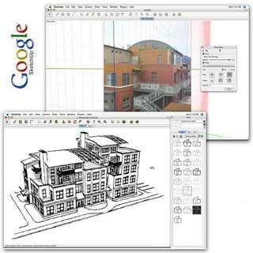
Sketchup/3D Warehouse

Slide 18
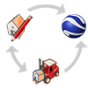
Overview
Introduce 3D Warehouse as a Information Repository
Artifacts crucial to a community
The importance of Acknowledgement
The importance of Challenge
The need to shift 3D Warehouse towards becoming a Social Network

Slide 19
Timeline
Formed Hypothesis
Altruism does not exist
Competition Fuels Contribution
Gathered Data
Gathered data from 40 3D Warehouse users and 20 Competition participants
Gathered model uploads for 10 quarters
Formed Conclusions
Created graphs but proved to be too scattered
Formed ratio that we believed would prove our hypotheses
Community Contributes
Rated models, blue ribbons, categories, avg. rating, avg. number of raters, number of reviews

Slide 20
3D Warehouse as a Information Commons
People
Name
Content
Buildings
Distribution
Model database
Feedback
Ratings
Reviews
Stars
Blue Ribbons
Logos
Other Models

Slide 21
Artifacts Crucial to a Community
Communication
Acknowledgement
Identity
Events
Source of Challenge
Exhibition

Slide 22

Acknowledgement
“If any civilization is to survive, it is the morality of altruism that men have to reject.” – Ayn Rand
Look at 3D Warehouse as a Gift Economy, Reciprocity
Social Capital: Blue Ribbons, Reviews, Stars
“It sure would be encouraging to get one of those juicy ribbons...” – Christopher B. , Sketchup User

Slide 23
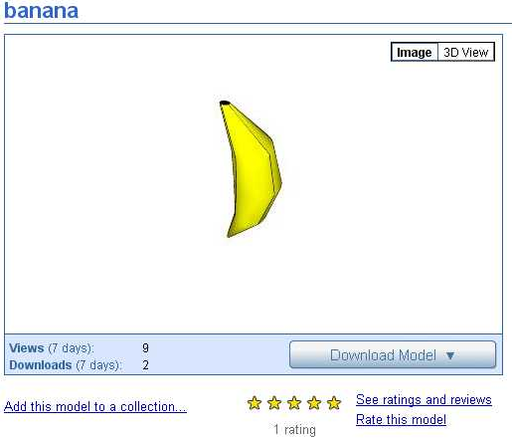
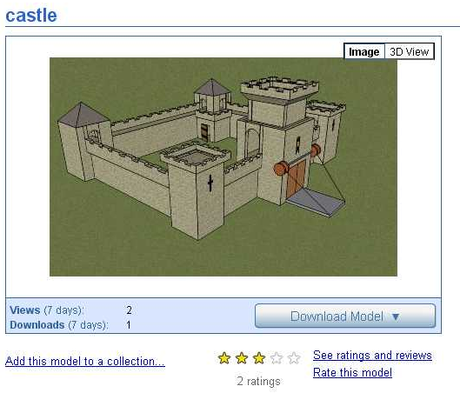
Star rating system is more of a feedback mechanism (avg. rating = 4.48)

Slide 24
35% of models created by Blue Ribbon holders have blue ribbons
Blue Ribbon holders contribute 7% more models than the average

Slide 25
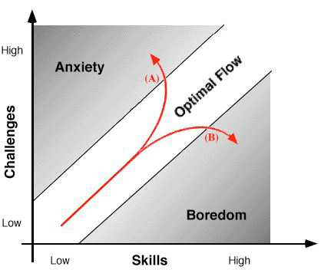
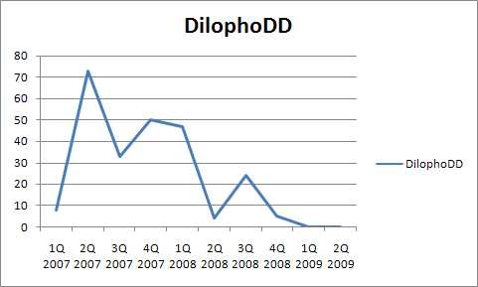
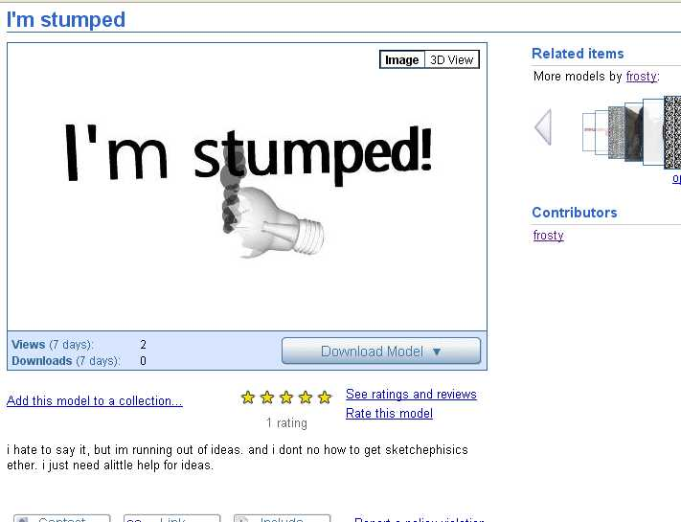
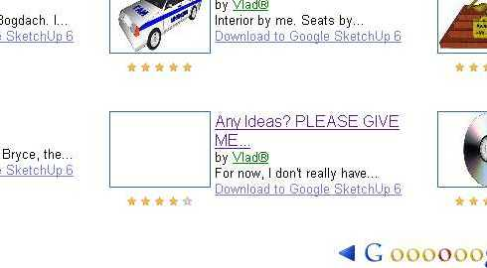
Challenge
Low drop out rate
Only a few categories (90% of users)
  Fields of interest
But:
  Activity decreases
  Users go out of ideas
Challenge can help!

Slide 26
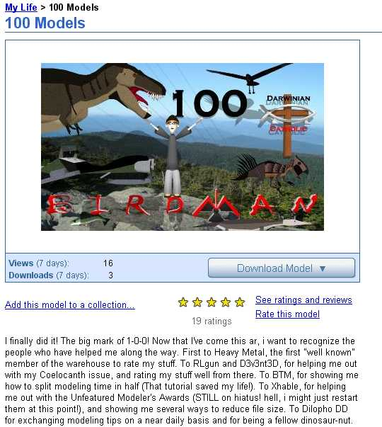
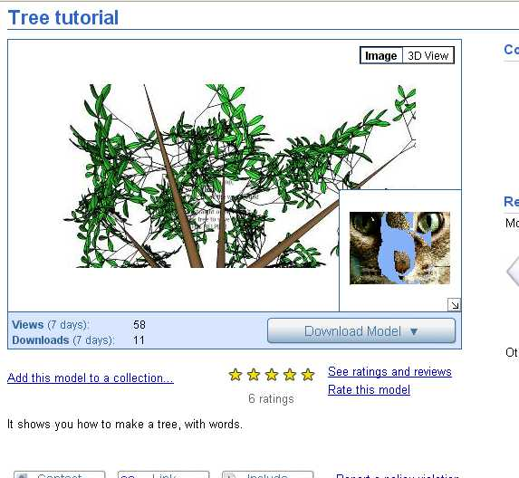
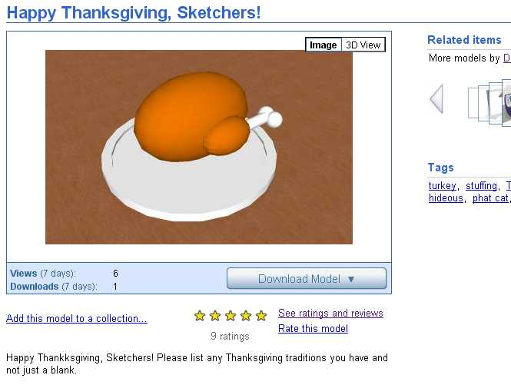
The Shift of 3D Warehouse
3D Warehouse
Information repository
Google SketchUp Group
Social network
People
Name
Content
Buildings
Distribution
Model database
Feedback
Ratings
Reviews
Stars
Blue Ribbons
Logos
Other Models
Identity
Profile
Education
(Tutorials)
Tutorials
Events
Challenges
Communi-cation
Discussions
Pages
Help Forums
Competitions
Use of appropriate technologies for needs
Tendency to bring the two spaces together
Conclusion: Rich community space with all artifacts is good solution

Slide 27
Competition Inside SketchUp
A comparison

Slide 28
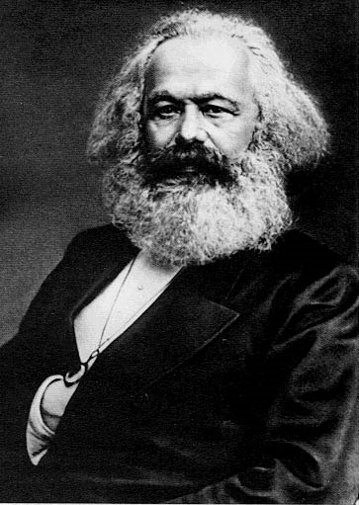

Slide 29
Karl Marx
1818- 1883

Slide 30
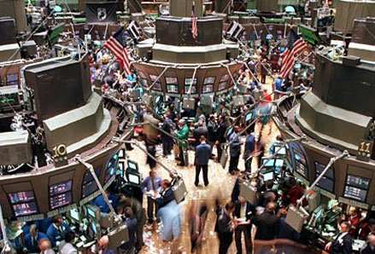
capitalism

Slide 31
Some Major Differences in the Meta Designs
Marx
capitalism
Working is our goal
People should belong to the same social class.
People should not own business directly, but sort of indirectly through the common government.
We are all rowing together, and the boat will go faster.
Collaboration.
Working is our goal
Social class is almost a reflection of abilities.
Not only should people own business, but monopoly or oligopoly is against the law.
We row individually, and everyone will want to finish first.
Competition.

Slide 32
Collaboration vs. competition
My approach:

Slide 33
Polar opposites
Competition
Collaboration

Slide 34
Common relation
collaboration
Competition
Collaboration

Slide 35
Other less common relation
collaboration
Collaboration
Competition
Competition

Slide 36
Findings thus far: overall quality better on competition models
& quantity/time higher during competition

Slide 37
UTILITY = VALUE / EFFORT

Slide 38
And Capitalism wins!

Slide 39

From Spatulas
to
Purple Dinosaurs

Slide 40
Data Collection and Methods
  Time period: December 7th, 2008 - March 16th, 2009
  Open exploration
    Reading and interacting with stories
  Scraping
    72047 Contributions
    3668 Stories
    5114 Authors
  Coding
    Manually classified messages and authors
    10129 Contributions
    895 Stories
    721 Authors coded for Gender
    189 Authors coded for Role

Slide 41
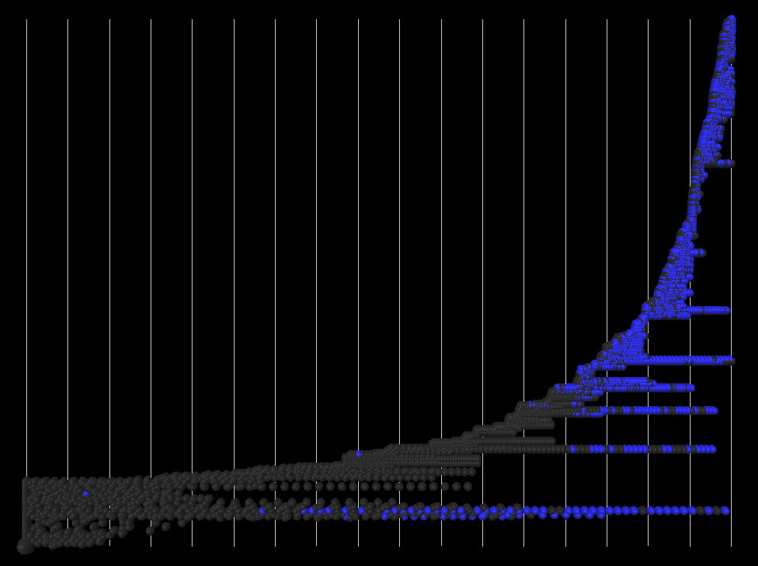
StoryGaps joins Facebook Jan 25 to Feb 10

Slide 42
Coding Scheme
Iteratively developed coding scheme.
By Story:
  Cohesiveness (1-4, whiplash to cohesive)
  Theme (violence, sexuality)
By Contribution:
  Cohesiveness (agrees with story theme)
  Theme
  Special words
  Role
By Author:
  Gender (Coded manually using name cues and FB search)
  Role (Auto-coded from aggregate contributions)

Slide 43
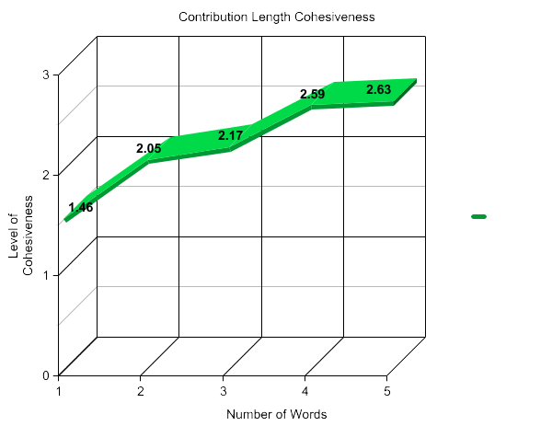
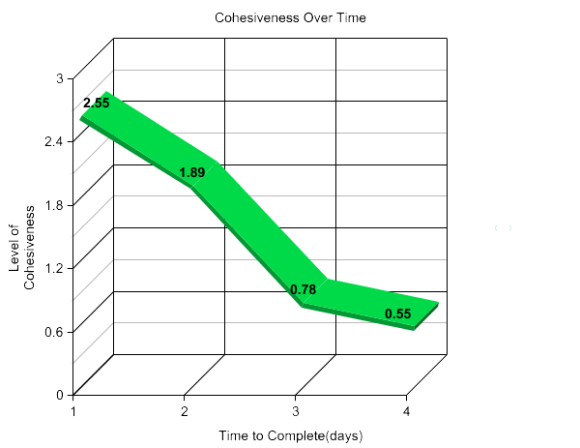
Cohesiveness

Slide 44
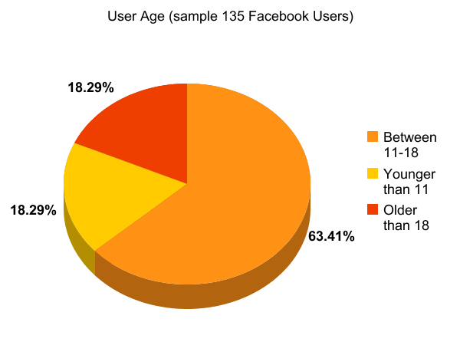
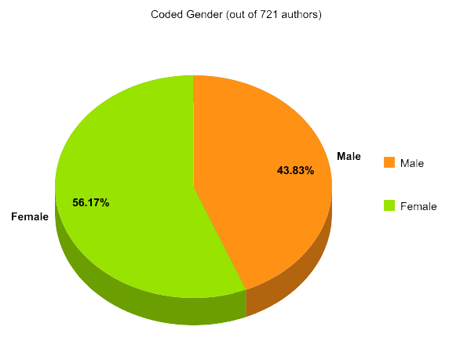
Users

Slide 45
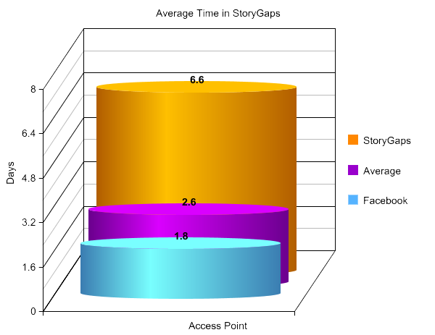
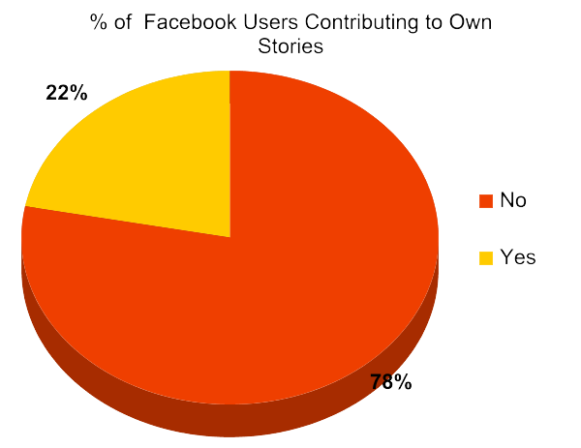
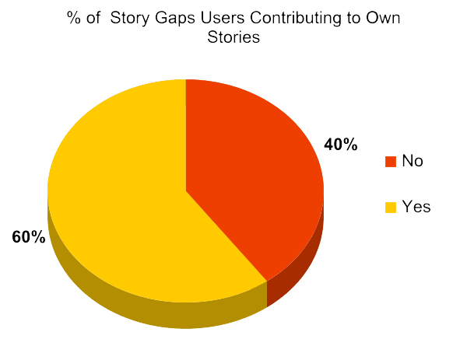
Facebook vs.
Storygaps

Slide 46
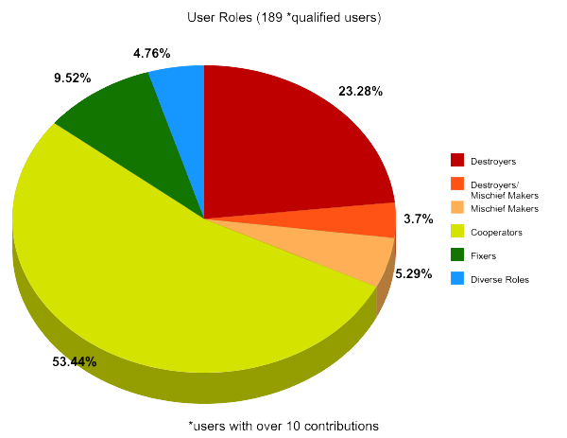
Roles

Slide 47
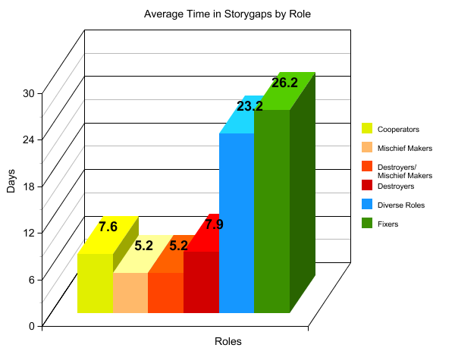

Slide 48
Richard Bartle’s Player Typology
  Achievers: goal to beat the game (f)
  Killers : goal to annoy other people (d)
  Socialisers: goal to meet other people (c)
  Explorers: goal to explore environment, limits (m)
Is StoryGaps a game?

Slide 49
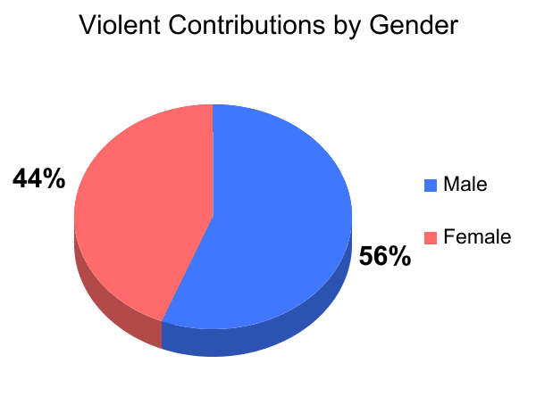
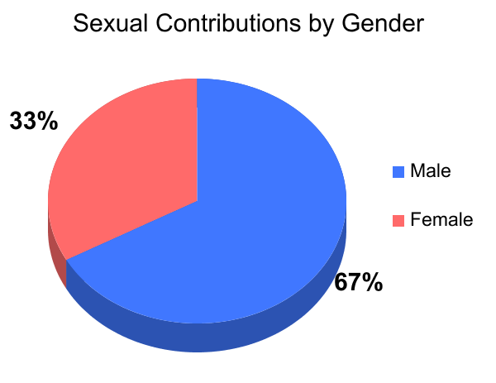
Themes of Contributions
  Of gender-coded users, 44% are male, 56% are female
  No significant difference in Food/Weight contributions

Slide 50
Spatulas, Llamas, and Purple Dinosaurs:
Special Words
  Some users introduce and then repeatedly use "special words" into their story titles, descriptions and contributions.
  Other users adopt these terms and perpetuate their use.
  Examples: Spatula, Llama, Barney the Purple Dinosaur, Fluffy Deltoids, Ninja, Flamingo, and the number 42
  Introducing terms: Establishing an identity, social capital
    At one point, the initiator of spatula asserts in a contribution, "I invented the spatula thing!"
  Perpetuating use: Social learning theory

Slide 51
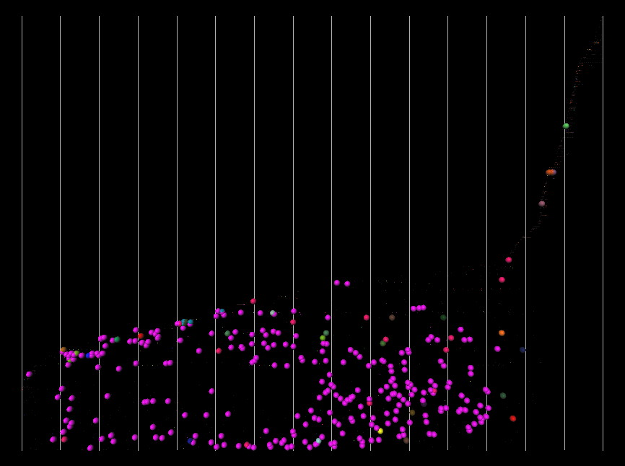
Spatulas - Feb 25 to Mar 2

Slide 52
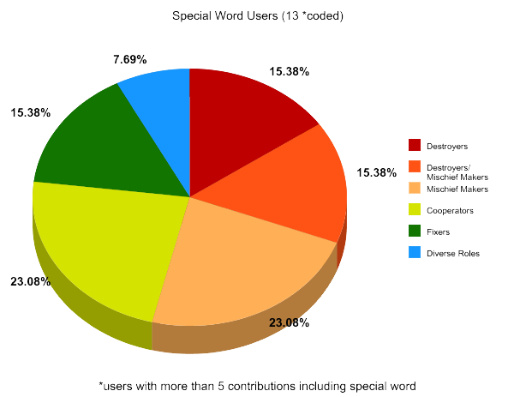
"Spatulas were annoying but funny"
~700 of 12500 coded and auto-coded messages
contain special words.
Mischievous authors the
most likely to use
special words.

Slide 53
Conclusions
  Low investment required to enter StoryGaps through Facebook App changed the culture of the collaborative environment.
  Possible motivations for participating and assuming certain types of roles include establishing a reputation, belonging to an online community, accumulating social capital, and the primal satisfaction (for some) of kicking over other peoples' sand castles.
  Other project themes active in StoryGaps are Time, Interaction, and Performance (TIP) Theory and Social Learning Theory

Slide 54
Motivation in Game Design Class

Slide 55
Education 2.0
Takes advantage of collaborative capabilities of the internet (Web 2.0)
Focus on how to learn, not what is learned
“Open source” environment for learning
Designed to increase collaboration on assignments between students
Equips students with the ability to learn things on their own
Prepares students for the job market of the 21st century

Slide 56
Similarities between SGD and DCNM
Projects displayed in public form on course website
Students are able to view and
comment on other students’ work
Students are encouraged to work together to
complete tasks and learn from each other

Slide 57
Differences between
SGD and DCNM
Scalable Game Design
Individual Projects
Inspiration mostly from other students in the class
Class time divided between collaborative designing and skill building
Students give/receive feedback directly to/from other students to improve their projects
DCNM
Group Projects
Inspiration mostly
from articles and discussion
Class time mostly focused on full class discussion and participation
Students give feedback to the class and other students internalize their ideas and apply it to their projects

Slide 58
Better Engagement in Class
Motivation?
Collaboration?
Inspiration?

Slide 59
FLOW OF INSPIRATION PRINCIPLES
These Principles should allow students to:
1) Display projects in a public forum
2) View and run fellow students’ projects
3) Provide feedback on fellow students’ projects
4) Download and view code for any project
5) Provide motivation for students to view, download, and give feedback on fellow classmates’ projects

Slide 60
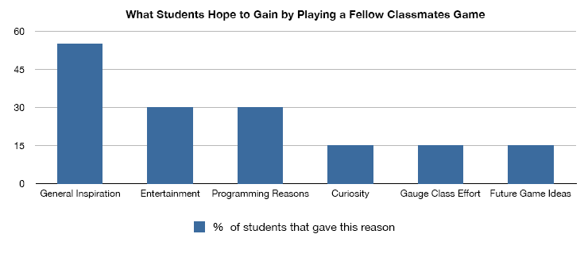

Slide 63
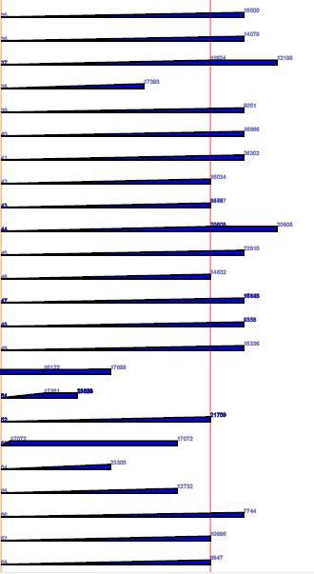
Game Complexity Growth

Slide 64
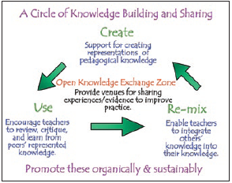
Knowledge building and sharing
Minds on Fire by John Seely Brown and Richard P. Adler

Slide 65
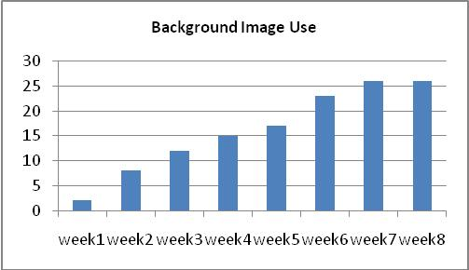
Game Feature Proliferation

Slide 66
