Slide 1

Umbre la Project
DCNM 2009

Slide 2
We are looking at motivation for contribution through three fronts:
Storytelling
Code Sharing
SketchUp

Slide 3
Collaborators:
Antonio Gonzales
Jeff Hoehl
Mikel King
Kyu Han Koh
Olga Liskin
Walter Mahfuz
George Paul McCabe
Jane Meyers
Kate Starbird

Slide 4
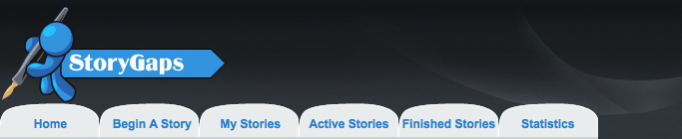
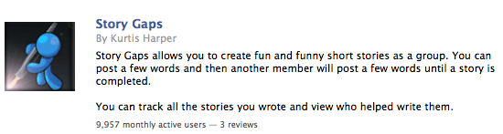
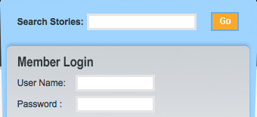
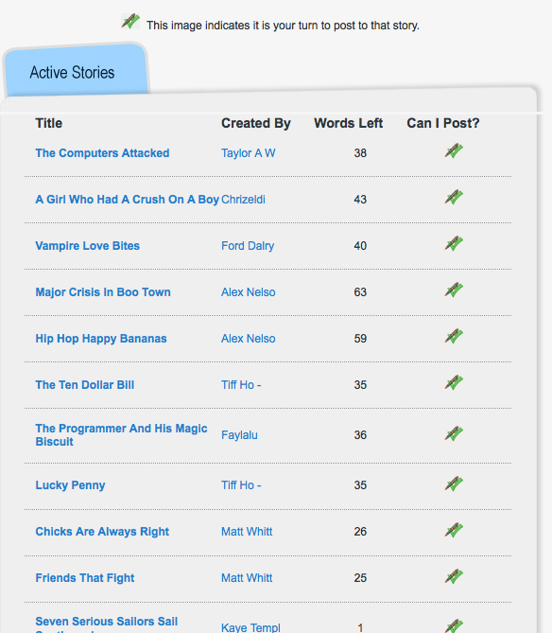
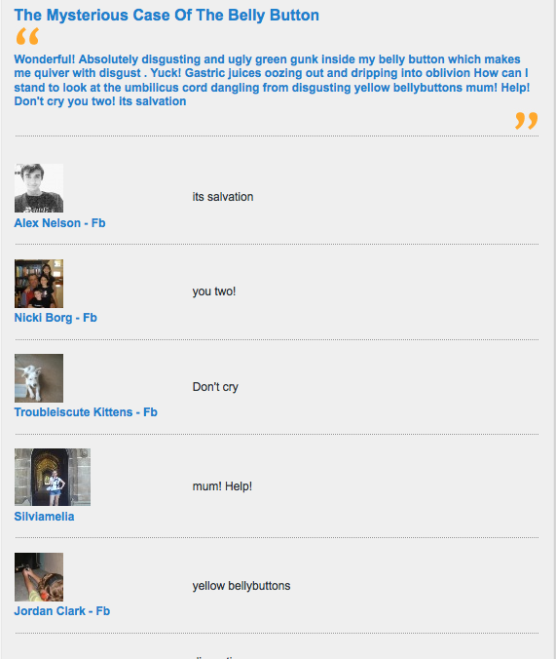
login
~10,000 monthly active users

Slide 5
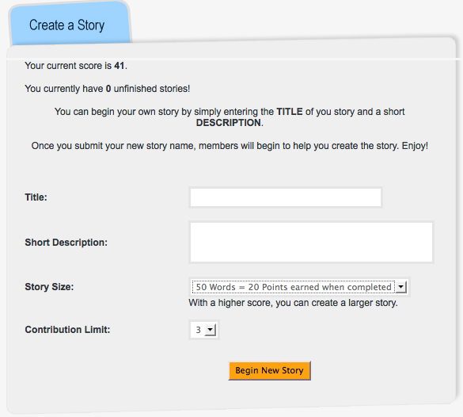
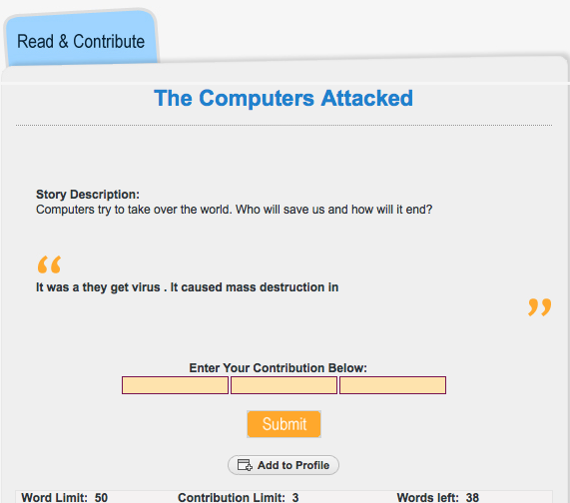
Story Gaps cont...
  Point system
  Contribution limit
  Grammar rules
  Reward system - longer stories

Slide 6
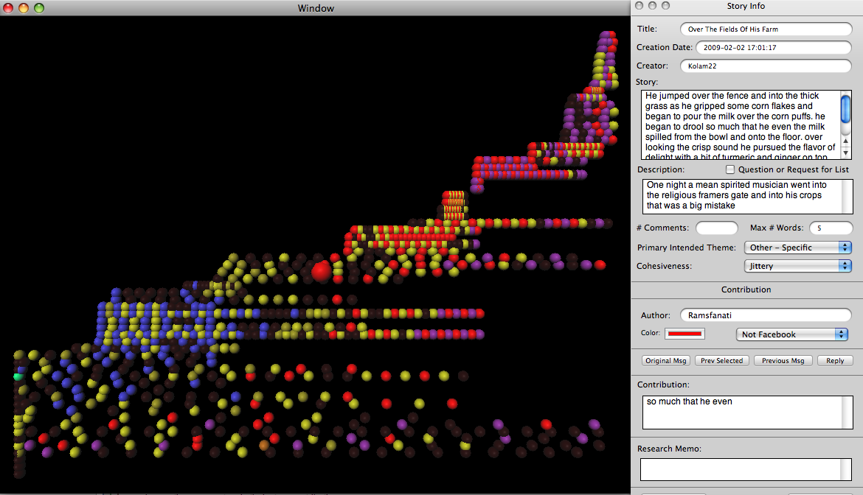
Data Analysis Tool

Slide 7
- Coding is changing
- User types identified:
  "mischievous"
  "destructive"
  "cooperative"
  "fixer"
- Groups
  many users tend to find "friends" with whom they "take turns" writing stories with.
Next phase:
  Concentrated effort on analyzing three windows of time
  Collecting statistics and creating data visualizations
  Coalescing results with other projects

Slide 8
Bring Web 2.0 to the classroom
-code sharing

Slide 9
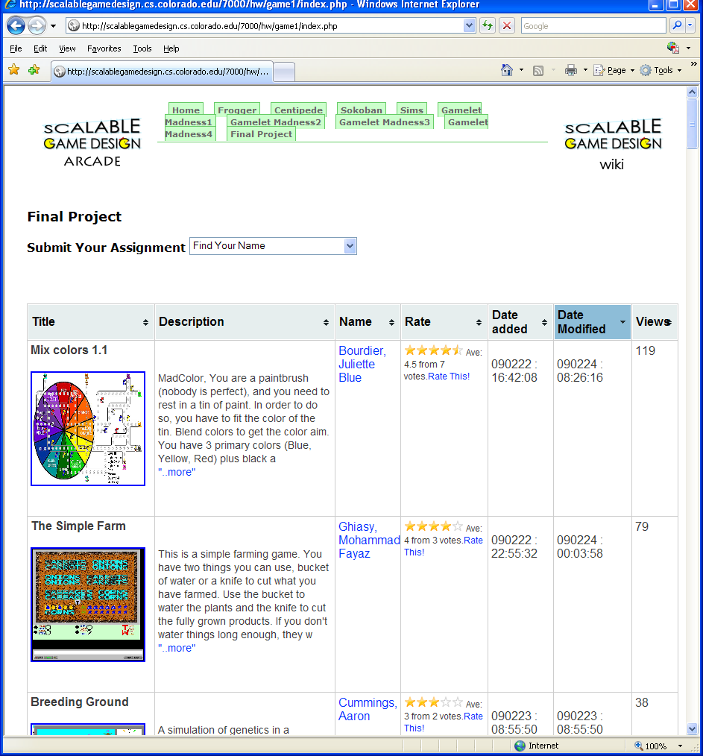
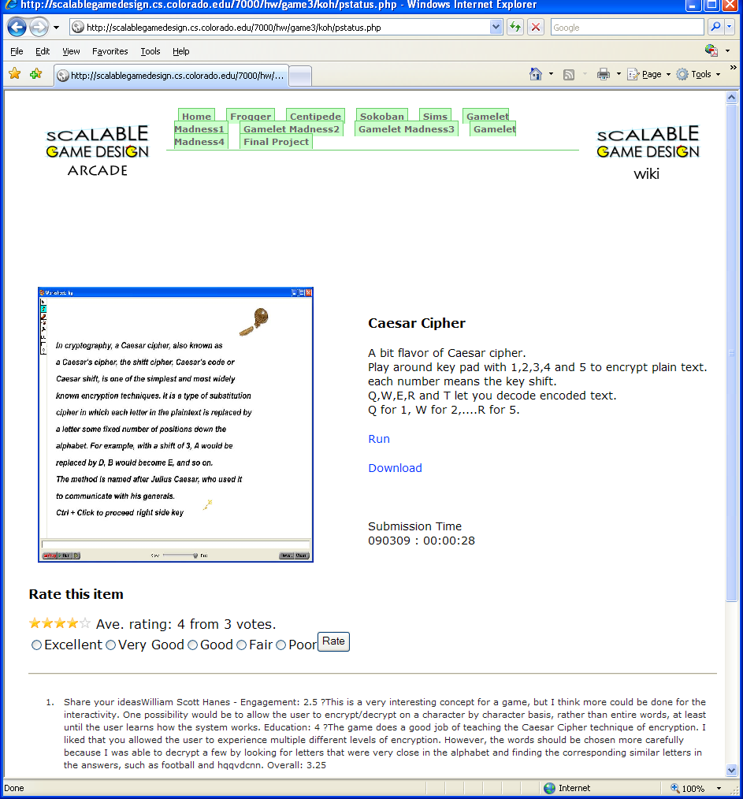
Testbed

Slide 10
Open Designed Class
Brings Web2.0 to the classroom
Does it make everyone be satisfied?
Copyright issue in the class?
Collaboration in the class?
Being inspired or giving inspiration

Slide 11
NEXT WORK
The benefits of collaboration in the class
How the complexity of game grows
The biggest motivation factor in the class

Slide 12

Hypotheses
Altruism Doesn’t Exist
Richness of Community Makes a Difference
Competition Fuels Contribution
Technological Support System for Community Increases Motivation

Slide 13
What Kept Us Busy
Formulating and Breaking down Hypothesis
Research
  SketchUp Histories
  Online Forums
  Online Groups

Slide 14
Preliminary Conclusions
The SketchUp community allows for different types of collaborations:
  Leisure
  Academic/Professional
  Individual
  Group
  Competitions
  Forums
Paradoxically, we have reached the conclusion that the contributions are not as numerous as we thought they might be, and what’s available is hard to track.

Slide 15
Next Steps
Examine in more details 3 communities
  Competition
  Group Based
  Forum Based
Compare degree of participation
Compare differences
Analyze how different technologies are applied
Find ways to measure richness of communities

Slide 16
THANK
YOU

